Slide 1
Maturity Model for Microsoft 365 Practitioners
Communication Competency
September 2021
⭐ Guest star ⭐ Tara Saylor | @AnokheeTara
Marc Anderson, Sympraxis Consulting | @sympmarc
Simon Doy, iThink 365 | @simondoy
Simon Hudson, Novia Consulting | @simonjhudson
Sharon Weaver, Smarter Consulting | @sharoneweaver
Initiative started by Sadie Van Buren as the SharePoint Maturity Model in 2010
Notes:
Simon D

Slide 2


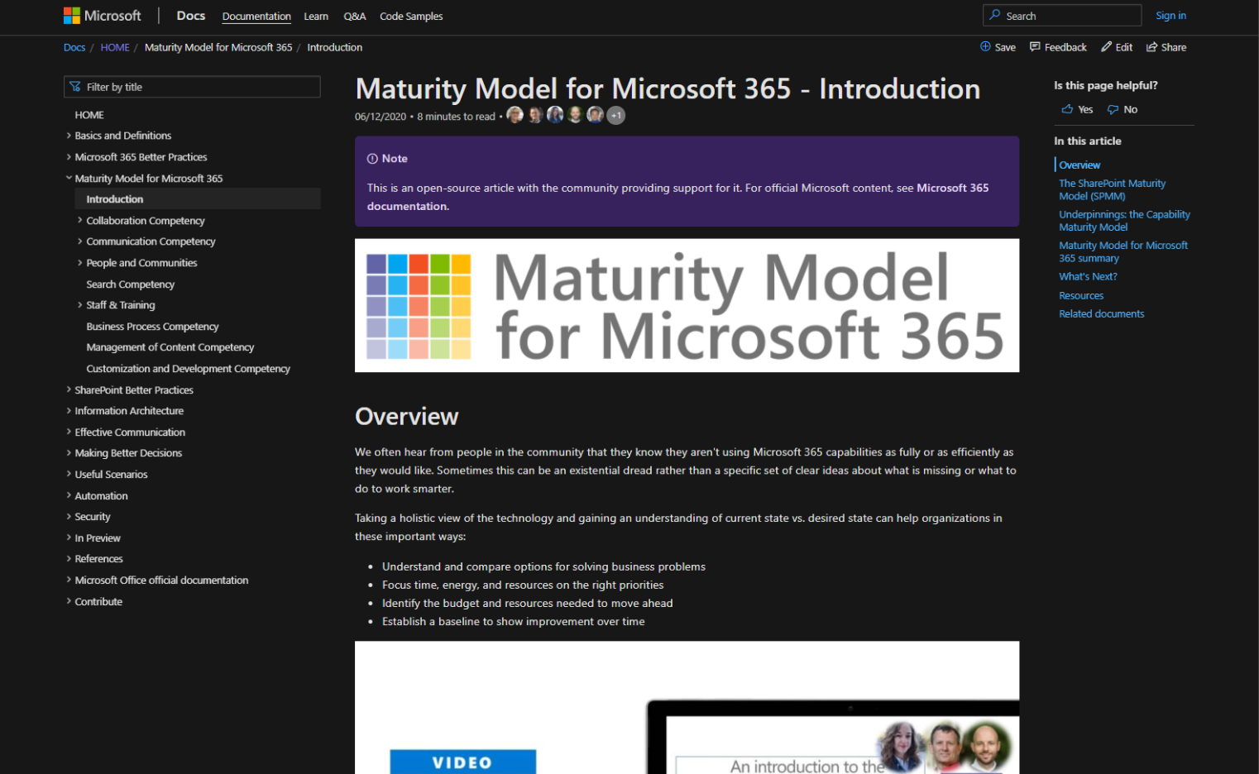
v
Agenda
Practitioner & Maturity Model overview
Artifacts and Updates
Purpose
How to get more involved
Shout-out & Picture Time (Together Mode!)
Discussion: Communication Competency
Notes:
Simon D

Slide 3

The approach and articles on Microsoft Docs
Artefacts
Improve organization through use of technology
Benchmark company and department
Select appropriate approach
Develop an organizational business and technical roadmap based on:
What's possible
What's desired
Organization's culture and drivers
Lead and support strategic planning, with senior management
Align implementation needs and objectives
Discuss use of the platform with IT – not just technology
Socialization tool
PURPOSE
Published Competencies
Supporting Articles
Business Process
Running a MM4M365 workshop
Principles of…
Collaboration
Practitioner meeting recordings
Search
Communication
Communication
Open Competencies
Management of Content
How to elevate…
In progress
People & Communities
Infrastructure
Collaboration
Search
To do
Communication
Security…
Staff & Training
People & Communities
Customization & Development
Data & Analytics
Staff & Training
Notes:
SIMON H
New resources: Running a workshop, plus associated workbooks

Slide 4
MM4M365 provides benchmarks to measure your organization
Maturity Level | Description | Intent
Level 500 Optimizing | Deliberate and systematic process improvement/optimization Focus is on continually improving process performance Addressing statistical common causes of process variation and iterative process improvement | Optimal, systematic, statistical, improvement-focus, automated, assured, proactive
Level 400 Predictable | Actively managed in accordance with agreed processes and has tracked metrics Effective achievement can be evidenced across a range of operational conditions Process has been tested and refined Process users demonstrate competence | Productive, interactive, responsive, enhanced, effective, adaptable, quality
Level 300 Defined | Defined and standardized Signed off, managed process Limited validation of effectiveness, doesn’t include edge cases Process users demonstrate familiarity | Documented, policy-driven, planned, controlled, stable
Level 200 Managed | Key processes defined but not standardized, uniformly or strongly applied Some ability to demonstrate consistent outcomes Limited buy-in from staff and management Widespread inconsistency and resistance | Routine, legacy, fire-fighting, variable, personally managed
Level 100 Initial | Default, starting/exploratory state People driven processes, lacking documentation and discipline Many ways of doing the same thing (with variable results) Characterised by inefficient legacy approaches and pockets of unmanaged innovation | Ad hoc, reactive, uncontrolled, chaotic, unstable, not designed
Notes:
SIMON H

Slide 5
MM4M365 – Intention at each level
Maturity Level | Description | Intent
Level 500 Optimizing | Deliberate and systematic process improvement/optimization Focus is on continually improving process performance Addressing statistical common causes of process variation and iterative process improvement | “We want to ensure all the key processes are always effective and resilient, while designing the same into anything new we do”
Level 400 Predictable | Actively managed in accordance with agreed processes and has tracked metrics Effective achievement can be evidenced across a range of operational conditions Process has been tested and refined Process users demonstrate competence | “Let’s make things even better by measuring, analyzing and taking actions to improve based on that“
Level 300 Defined | Defined and standardized Signed off, managed process Limited validation of effectiveness, doesn’t include edge cases Process users demonstrate familiarity | “We have defined our processes, policies and procedures, everyone seems to be doing the right thing; let’s keep doing that”
Level 200 Managed | Key processes defined but not standardized, uniformly or strongly applied Some ability to demonstrate consistent outcomes Limited buy-in from staff and management Widespread inconsistency and resistance | “We should ensure everyone knows what they should be doing”
Level 100 Initial | Default, starting/exploratory state People driven processes, lacking documentation and discipline Many ways of doing the same thing (with variable results) Characterised by inefficient legacy approaches and pockets of unmanaged innovation | “Let’s keep putting the fires out and keep the lights on!”
Notes:
SIMON H

Slide 6
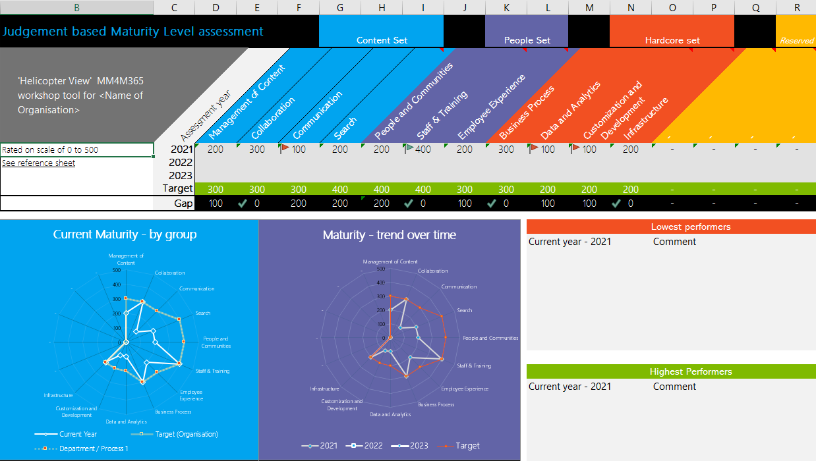
Purpose
Discussion-based monthly meeting
Highlights of new assets
Understanding the competencies
Mapping technology to maturity levels and competencies
Running a workshop
Measuring maturity
Sharing anecdotes and success stories
Feedback on the maturity model
Safe space to hone your pitch, test your thoughts, or decide how to promote your use of the Maturity Model
OVERVIEW
Practitioners for
Maturity Model
for Microsoft 365
Get Involved
https://aka.ms/sharing-is-caring
Present case study (at MM4M365 Practitioners or other speaking opportunities)
Contribute on GitHub
Provide feedback, insights, tools, and artifacts
Socialize
content
Run a MM4M365 workshop
https://symp.info/MM4M365Workshop
Recordings
http://mmvideos.m365.ms/
Notes:
Simon H

Slide 7
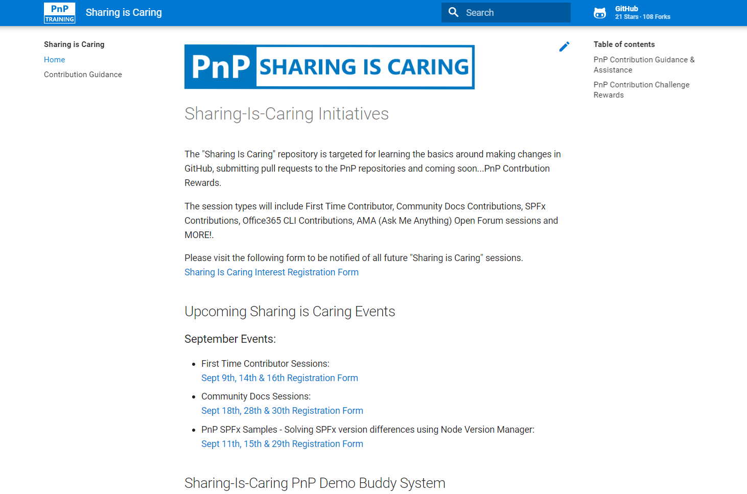

GUIDANCE
Get started on the open-source and community work?
Community Docs Sessions
Monday, 5th October, 1pm PST
First Time Contributor Sessions
Tuesday, 21st September, 2pm PST
Thank you, August attendees
Aaron Blair
Abdush Miah
Amin Tavakoli
Andrew Burns
Anna Sanfilippo
Annie Torres
Ashar Khan
Chris Mccreath
Christian Jacob
Christine Green
Daniel Westerdale (iThink 365)
David Warner II
Derricott, Tony
Doug Ast
Duffy, Mike
Edris KAKEMBO
Gissur Simonarson
Graves, Chris
Harold Wolfinger
Henrik Yllemo
Jason Lambiris
Jenna R McGee
Joanne Klein
Joni Jackson
Kathleen Boilek
Lance Yoder
Lori Kuebel
Manjunath Puttaswamy
Manjunath Siddappa
Marc Anderson
Marcelo Lorca
Melissa Declercq
Miller, Caleb
Nicole J Fleming
Patrick Tucker
Pete Simpkins
Ralph Rivas
Rob Bell
Rocio Holub
Ron Jones
Sabrina Faragoza
Sam Bridegroom
Sarah Bruty
Sean Garvin
Sharon Weaver
Simon Ågren
Simon Doy
Simon Hudson
Simon Thompson
Steven Reid
Sue McGuire
Theresa Lubelski
Tim L Balk
Varol Saatcioglu
Next MM4M365 call
October 19th at 7:00am PST
Topic: Collaboration Competency
Third Tuesday of every month
https://aka.ms/sharing-is-caring
https://aka.ms/sharing-is-caring
Notes:
Simon D

Slide 8
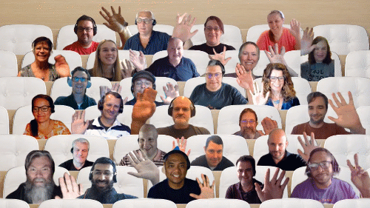

PnP Picture Time!
Please turn your video on
we’ll grab a Together Mode pic with everyone who wants to be seen to be here.
We are together in this as a community!
August 2021
Notes:
Simon H

Slide 9
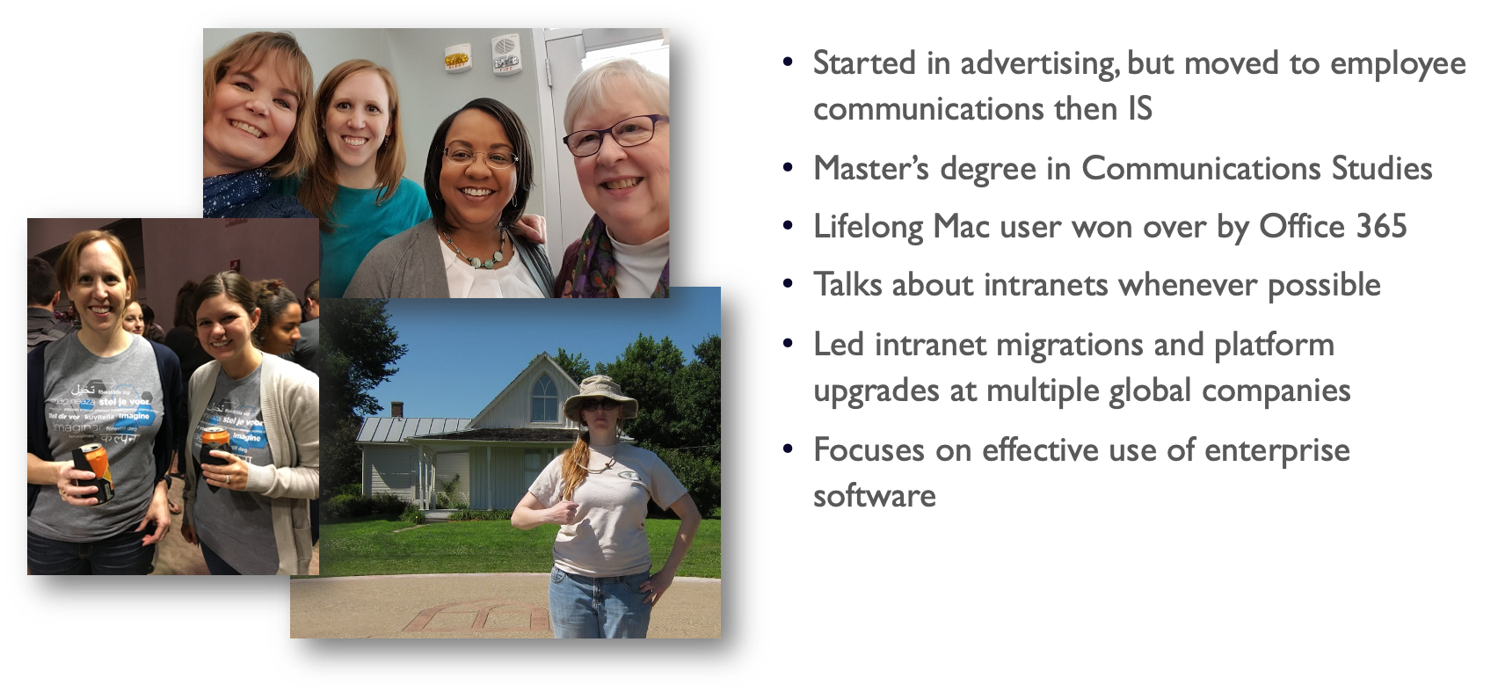
How I became a communications nerd
Notes:
Introduce Tara - Simon D

Slide 10

DISCUSSION
Communication Competency
PROTOCOL
Visually emote and support Share reactions while others are speaking
Come off mute and share your thoughts
Share your camera (don’t be shy)
Raise your hand to say your piece (and put it down again!)
Notes:
Simon D – introduction and introduce our rock star presenter

Slide 11







DISCUSSION: What is communication, anyway?
Sender
Recipients
Notes:
The simplest definition of communication is that someone, a sender, packages up a message and delivers it through a channel to recipients.
It gets more complex quickly: Did the recipient see it? Did they understand it the way the sender intended? Did they get all the information needed?
Sending an email does not guarantee the desired results....

Slide 12
DISCUSSION: What is communication, anyway?
Sender
Recipients
Notes:
There's a second step that isn't always part of the discussion, and that's feedback from the recipients to the sender. It could be very quick and informal, or it could be information shared via something like a survey

Slide 13
DISCUSSION: Message complexity
Tactical
Strategic
Product Inventory
Corporate Acquisition
Simple
Complex
System Outage
Redundancy plans
Informal
Regulated
Company Party
Earnings Call
Local
Global
Team update
Team update!
Notes:
Generally, the more to the right it is, the more sophisticated it is.
Tactical and local is an email that says "hey, parking garage is closed."
Tactical and Complex is return to office information
Regulated is the extreme end point- think SEC filings or ​things coming from HR about a merger. It could also be internally discussed and reviewed, like strategy messages.
Global could start to include translations and localizations.

Slide 14





Conversation and Collaboration Modes
Type
Example
Try this …
Quick, transitive, low importance
“Want to grab a sandwich?
"Which sandwich shop should we order from for the department from now on?"
Making decisions, group think
External, formal
“We’d like to work on a sandwich with you.”
Seeking help, crowdsourcing
“Who knows about sandwiches?”
Strategic
“NDA: We’re planning to start a sandwiches division.”
Informational, inspirational
“We see that sandwiches are trending up.”
Personal, confidential
“We’re firing the sandwich guy – YOU!”
Notes:
Thank Marc Anderson

Slide 15
The Technology is here. Level 5 capabilities are available.
Very few organizations are above Level 3.
Notes:
You may need to buy a few third-party things to really get all the bells and whistles, like bananatag or politemail, but they're in the Microsoft ecosystem.
Why? Communications is a cost- no revenue.
You don't necessarily need sophisticated communications for a 5-person shop. Or even a 50 person office.
You may have "informal communicators," like members of senior leadership, who are naturally good at it, so it's happening organically.
Communications infrastructure takes time and energy to maintain well, and we are all busy people.

Slide 16
MM4M365 – Intention at level 100
Maturity Level | Description | Intent
Level 100 Initial | Ad hoc and as needed Messages planned and prioritized by what's happening now Limited audience segmentation, if any (all employees) Created and sent by leaders or voice of authority Minimal concern about conflicted messages or message volume | “This is my area, and I'll update everyone as when there's something to say”
Notes:
SIMON H

Slide 17
MM4M365 – Intention at level 200
Maturity Level | Description | Intent
Level 200 Managed | Established channels and channel owner, but likely not full focus (may be many senders in different areas of the org) Some process (proofreading, request for channel use) but messages delivered when requested Not centralized or archived Push messages primarily- not self-service content or two-way engagement May ask for "vanity metrics" like page views, email opens, etc | “Send this email from the HR Inbox on Tuesday so they know it's open enrollment”
Notes:
SIMON H

Slide 18
MM4M365 – Intention at level 300
Maturity Level | Description | Intent
Level 300 Defined | Defined and standardized communications approach (mix of full-time and part-time communicators) but communicators focused on individual audiences Surveys and other high-level feedback tools Preferred tools for different needs (this is our intranet. We post like this.) High-level audience targeting (geography, job title, other HR data) Established communication infrastructure with checks and gates (main DLs locked down, approval process for new intranet articles) Regular cadence for key messages established and maintained Communications calendar follows corporate calendar (open enrollment, year-end closing, big business milestones) focused on What with some Why Governance documents for key channels like email, intranet | “We have defined our processes, policies and procedures, everyone seems to be doing the right thing; let’s keep doing that”
Notes:
SIMON H

Slide 19
MM4M365 – Intention at level 400
Maturity Level | Description | Intent
Level 400 Predictable | Move from event-driven communication to campaigns Content delivered via multiple channels, with messages appropriate for each (Teams and Email and Intranet) Opt-in lists and more sophisticated targeting (length of tenure, groups that don't line up with org charts) Process users demonstrate competence and understand reasons Use past analytics to plan future messages and strategies (“Wow, stories about X generate engagement in comments. Let's do more.") Out-of-date content is managed or removed (I'd love that to happen sooner, but it's hard to do) | “We know associates are likely to take action when we send email on behalf of the CEO, so we planned that for launching the new strategic project.“
Notes:
SIMON H

Slide 20
MM4M365 – Intention at level 500
Maturity Level | Description | Intent
Level 500 Optimizing | Internal systems mirror customer journeys and marketing best practices Message delivery systems reflect user preferences Communicators serve as SMEs on company initiative teams Analytics used to adapt tactics during outreach ("hmm, no one clicked on that email link. Let's try a rewrite and push again on Thursday") and tied to actual business objectives and priorities Holistic content, branding and user engagement strategies exist and are actively managed Close partnerships between tool owners and content creators | “We want to ensure all the key processes are always effective and resilient, while designing the same into anything new we do”
Notes:
SIMON H

Slide 21
DISCUSSION: Recommendations
Make sure it works
Distribution lists and groups include the people you think they do.
Everyone knows which tool makes the most sense for what messages.
Make it easy
People are intimidated by technology, and doing broad communication puts a spotlight on any mistakes.
Notes:
Communication doesn’t have to be this mushy, vague thing. It doesn’t need to be scary.

Slide 22
A few resources
Writing for the web
Plain language checklist
Duarte persuasive presentations
Copyblogger guide to engaging emails
Pexels for free quality stock photos
A List Apart for website best practices
Nielsen Norman Group for Intranet benchmarking and UX
Plan your message worksheet
Maturity Model for Microsoft 365 – Introduction
Notes:
Communication doesn’t have to be this mushy, vague thing. It doesn’t need to be scary.

Slide 23
Q&A Recording off!

Slide 24
Future topics
Search
Business process
Collaboration
Infrastructure
Accessibility & the Maturity Model

Slide 25
Thank you
Follow us on Twitter
@M365Maturity | @M365CommDocs
Take the Maturity Model Self-Assessment: https://symp.info/MM4M365-SelfAssessment
Fill out the Maturity Model Survey: https://symp.info/MM4M365Survey
Discussions in Github: https://symp.info/MM4M365Discussion
YouTube: https://symp.info/MM4M365Videos
Slide decks:
Next MM4M365 monthly call: Oct 19th 10am ET / 7am PT
Third Tuesday of every month
https://aka.ms/sharing-is-caring

Slide 26


aka.ms/m365pnp

